Slide 1

REV3 - Remote Control of Your Lego EV3
ECE 573, Spring 2016
Project
Beta Release
April 15, 2016
Team: bpwalsh

Slide 2
REV3 Beta Release Tasks: Planned vs Completed
Task | Target Release | Requirements Addressed | Responsible Team Member | Status
Drive control screen UI finalized and implemented | Beta | B.2.1,A.2.2,A.2.3 (Partial) | Bryan Walsh | Complete
Protocol processing implemented and tests developed(Transmit Command Use Case) | Beta | B.3.1,B.3.2 | Bryan Walsh | Complete
Start up use case implemented and tests developed | Beta | B.1.1 | Bryan Walsh | Complete
Turn command (Gyro) implemented and tests developed | Beta | B.2.5 | Bryan Walsh | Complete
Set power level (GUI) implemented and tests developed | Beta | B.2.1 | Bryan Walsh | Complete
Turn command (GUI) implemented and tests developed | Beta | A.2.2 | Bryan Walsh | Complete
Beta release testing conducted according to Requirements Verification Plan. | Beta |  | Bryan Walsh | Complete

Slide 3
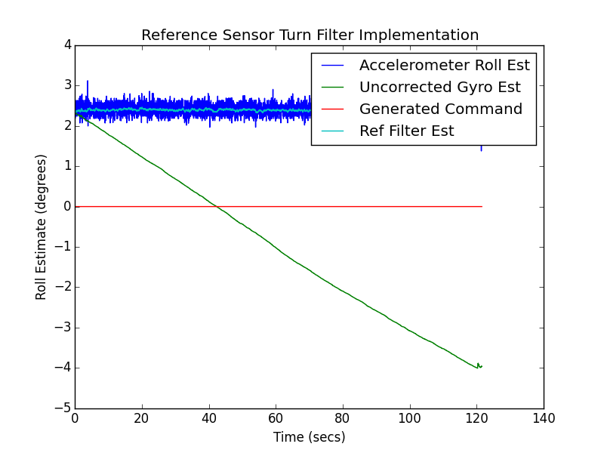
Reference Filter For Sensor Based Turn:
Phone at 0 Degrees Rotation
Complimentary Filter
Eliminates Gyro Drift
Uncorrected Gyro Estimate
with Gyro Drift
REV3 Turn Filter Tested To Be Within 0.00001 Of
Reference Implementation

Slide 4
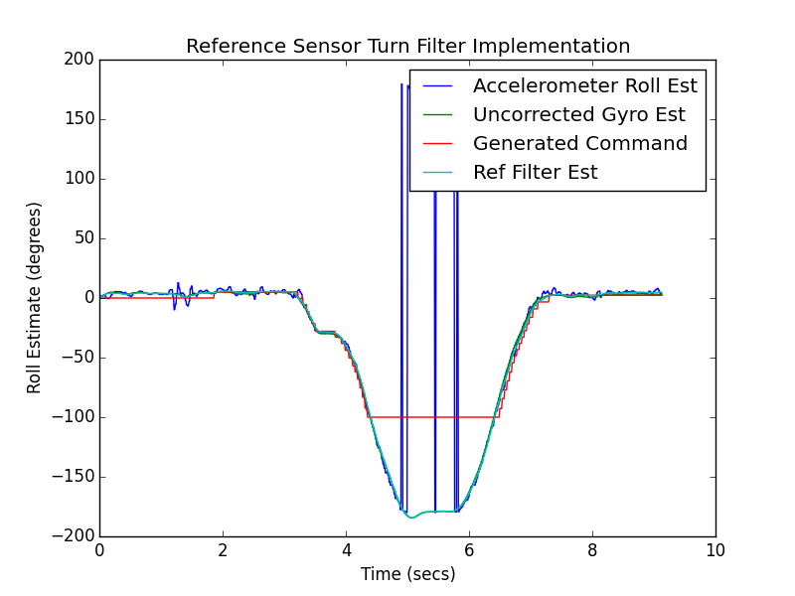
Reference Filter For Sensor Based Turn:
Phone Rotated Left to 180 Degrees
Accelerometer Roll Estimate Flips,
Correctly Handled by
Complimentary Filter
Command Capped
at -100
REV3 Turn Filter Tested To Be Within 0.00001 Of
Reference Implementation

Slide 5
REV3 Alpha Release Tasks: Planned vs Completed
Task | Target Release | Requirements Addressed | Responsible Team Member | Status
Initial Drive Control Screen UI Developed | Alpha | B.2.1,A.2.2,A.2.3 (Partial) | Bryan Walsh | Complete
Drive Control UI Activity Callbacks Implemented | Alpha | B.2.1,A.2.2,A.2.3 (Partial) | Bryan Walsh | Complete
Configuration Dialog Implemented | Alpha | B.1.1 (Partial) | Bryan Walsh | Complete
Command Processor Stubbed Out | Alpha | X.2.X (Partial) | Bryan Walsh | Complete
Protocol Processor Stubbed Out | Alpha | X.3.X (Partial) | Bryan Walsh | Complete
Protocol Finalized, Command Recording Implemented | Alpha | B.3.1,B.3.2 (Partial) | Bryan Walsh | Protocol Finalized/Recording Not Implemented
Turn Command (Gyro) Use Case Implemented | Alpha | B.2.5 (Partial) | Bryan Walsh | Initial Implementation
Additional Items Implemented:
“About” Dialog with Licensing Information
Snazzy New REV3 Application Icon

